Slide 1


IoT-Based Weather Monitoring System
Using NodeMCU ESP8266
An Embedded Systems Mini Project
Team MEMBERS:
S20240020285
S20240020314
S20240020315

Slide 2

Project Objective
This project aims to design and develop a comprehensive IoT-based weather monitoring system that captures critical environmental data including temperature, humidity, rainfall, and light intensity. The system transmits this data in real-time to the Blynk cloud platform, enabling users to monitor weather conditions remotely from anywhere using a smartphone application. By combining embedded systems with cloud connectivity, this project demonstrates practical IoT implementation for real-world environmental sensing applications.

Slide 3
Why Weather Monitoring Matters
Agriculture & Farming
Smart Cities
Environmental Protection
Optimize irrigation schedules and crop management based on real-time environmental data
Monitor urban climate conditions for traffic management, pollution control, and public safety
Track ecological conditions and detect anomalies for conservation efforts
Weather monitoring is essential across multiple domains. This system leverages NodeMCU ESP8266's Wi-Fi capabilities to collect sensor data continuously and transmit it to the Blynk cloud platform, enabling anywhere, anytime access through a mobile application. The integration of multiple sensors provides comprehensive environmental insights that support decision-making in agriculture, urban planning, and environmental science.

Slide 4

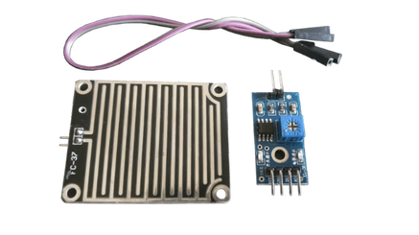
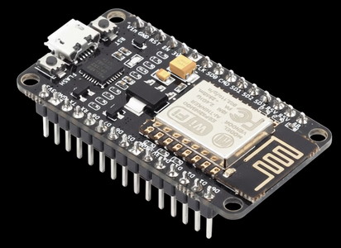
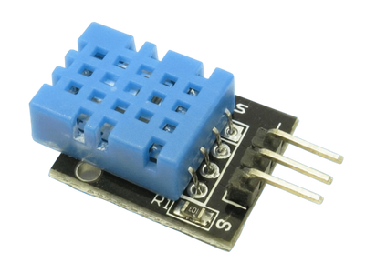
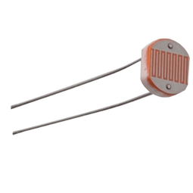
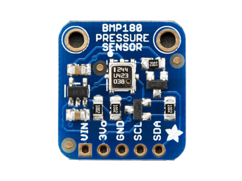
Hardware Components
1
2
3
NodeMCU ESP8266
DHT11 Sensor
Rain Sensor
Wi-Fi enabled microcontroller with built-in IoT capabilities for data collection and transmission
Digital temperature and humidity sensor providing accurate environmental readings
Detects precipitation and measures rainfall intensity through analog output
4
5
6
LDR Sensor
BMP180 Sensor
Supporting Components
Light Dependent Resistor measures ambient light intensity for solar radiation data
The BMP180 is a digital sensor used to measure atmospheric pressure and temperature. It communicates via the I²C interface and provides highly accurate data for weather monitoring and altitude calculation.
Breadboard for prototyping, jumper wires for connections, and power supply (3.3V)

Slide 5

System Architecture
Sensor Data Collection
DHT11, Rain, and LDR sensors gather environmental data
Data Processing
NodeMCU ESP8266 aggregates and processes sensor inputs
Real-time Environmental Monitoring
An IoT system for tracking environmental conditions
Cloud Transmission
Wi-Fi sends processed data to the Blynk Cloud platform
Mobile Visualization
Real-time display of environmental data on a mobile app
The system follows a modular architecture where distributed sensors collect environmental parameters. The NodeMCU ESP8266 acts as the central processing unit, aggregating sensor readings and managing Wi-Fi communication. Data packets are transmitted securely to the Blynk cloud platform, which stores and visualizes the information for user access through mobile and web applications.

Slide 6
Circuit Connections & Pin Configuration
Sensor Component
Pin Connection
Notes
DHT11 (Data)
GPIO D4 (Pin 2)
Digital signal with internal pull-up required
Rain Sensor (Analog Out)
A0 (ADC)
Analog input, 0-1023 range
LDR Sensor (Analog Out)
A0 (ADC) via MUX
Can be multiplexed or use separate channel
Power Supply (VCC)
3.3V
Regulated power for all components
Ground Reference
GND
Common ground for all circuits

Slide 7

Operating Principle
Environmental Sensing
Distributed sensors continuously detect temperature, humidity, rainfall, and light intensity from the environment
Data Collection
NodeMCU reads analog and digital signals from sensors via GPIO pins and ADC converter
Processing & Validation
Microcontroller processes raw sensor values, applies calibration, and validates data quality
Cloud Transmission
Data is formatted and transmitted to Blynk servers via Wi-Fi at regular intervals
Real-Time Visualization
Blynk app displays live readings using interactive gauges, graphs, and numerical displays

Slide 8







Software Development Environment
Arduino IDE
Blynk Mobile App
Integrated development environment for writing, compiling, and uploading firmware to NodeMCU boards with ESP8266 board support
Cross-platform application for iOS and Android enabling real-time data visualization and remote device control
Required Libraries
ESP8266WiFi.h (Wi-Fi connectivity), BlynkSimpleEsp8266.h (cloud integration), DHT.h (sensor communication)

Slide 9
Firmware Implementation
Key Programming Steps:
1
Initialize Wi-Fi Connection
Configure SSID, password, and establish connection to local network using WiFi.begin()
2
Authenticate with Blynk
Set authentication token and initiate connection to Blynk server through Blynk.connect()
3
Read Sensor Data
Continuously sample DHT11 digital output and convert analog signals from rain/LDR sensors
4
Process & Format Data
Apply sensor calibration coefficients and format values for transmission to virtual pins
5
Periodic Cloud Sync
Send aggregated sensor data to Blynk virtual pins at configurable intervals (typically 10-30 seconds)

Slide 10
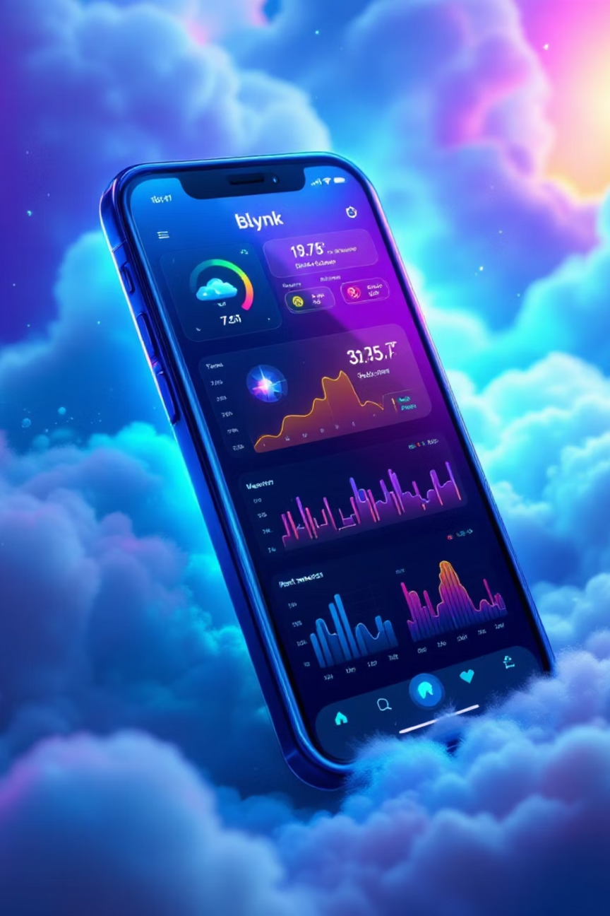
System Output & Real-World Applications
Blynk Dashboard Features
Practical Applications
Gauge Widgets: Analog displays for temperature and humidity ranges
Smart Agriculture: Automated irrigation scheduling based on rainfall and humidity
Graph Visualization: Historical data trends over hours or days
Environmental Monitoring: Pollution tracking and ecological impact assessment
LED Indicators: Visual alerts for threshold violations
Smart Homes: Climate control and energy optimization
Numeric Displays: Real-time values with units and precision
Educational Stations: Weather monitoring infrastructure for schools

Slide 11
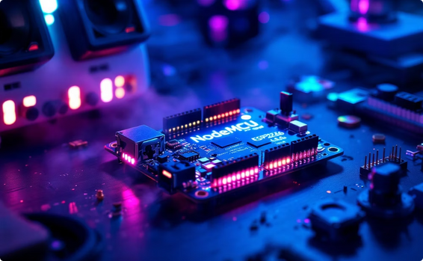
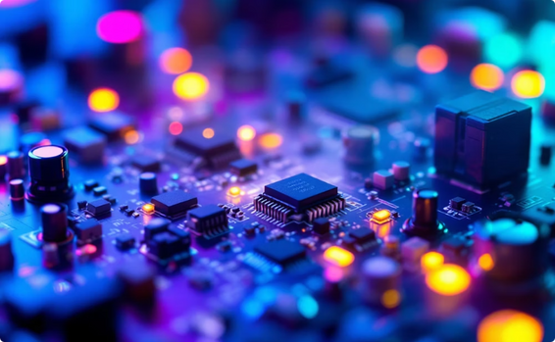


THANK YOU.
We appreciate your attention to our presentation on the IoT Weather Monitoring Project. Here's a brief summary of the key components and their impact:
IoT Core: NodeMCU ESP8266
Sensor Integration
Cloud Connectivity via Blynk
Real-World Impact
Seamlessly integrated environmental sensors for accurate real-time data acquisition of temperature, humidity, and more.
From smart agriculture to environmental monitoring, our system provides actionable insights for diverse practical applications.
The foundation of our system, leveraging the powerful ESP8266 for efficient data processing and connectivity.
Utilizing Blynk for robust cloud integration, enabling remote monitoring and intuitive dashboard visualization of data.

